Slide 1
MicroMBA: Introduction to Finance
Rossen Valkanov
July 11, 2017

Slide 2
Preliminaries
Professor Rossen Valkanov
      Email: rvalkanov@ucsd.edu
      Phone: (858) 534-0898; Office: 4.139 (Otterson Hall, UCSD)
Today’s agenda:
  The investment environment—overview and perspective
      A lot has changed since 2007!
  Time Value of Money (present and future values)
  Valuation (of a project, company, etc.)
  Model of Risk-Return Tradeoff: CAPM
  Capital budgeting rules: NPV, IRR, PI, ROI

Slide 3
News: Valuation and Growth in Tech
Uber Raises Funding at $62.5 Billion Valuation
Bloomberg, 12/03/2015
Uber Technologies is looking to raise as much as $2.1 billion in a financing round that would value the car-booking company at $62.5 billion…
The new funding shows Uber is accelerating its race to expand globally and branch into services beyond picking up and dropping off riders. The company has tested food and package delivery in some cities, and is working on new technology, such as self-driving cars. Uber is spending aggressively to expand throughout Asia, particularly in China, where the company expects to spend $1 billion…
As part of the current financing round, Uber has closed investments from Tiger Global Management and T. Rowe Price, and it’s also seeking strategic investors with shared business interests…
Tiger Global backs some of Uber’s main competitors outside of the U.S., including China’s Didi Kuaidi, India’s Ola, and Singapore’s GrabTaxi. Didi Kuaidi raised about $3 billion in a round this year, people familiar with the matter had said.

Slide 4
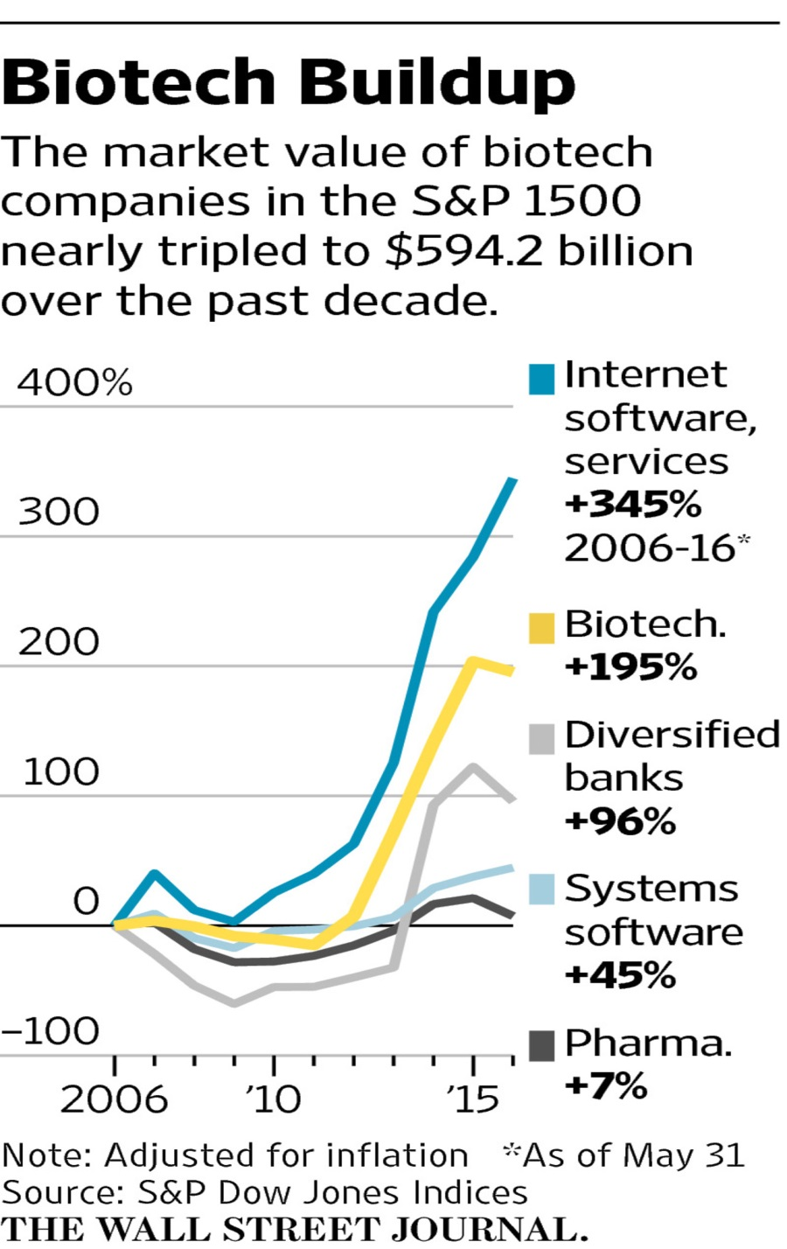
News: The Growth in Biotech
Biotech Labs Birth New Drugs—and New Fortunes
WSJ, June 24th, 2016
New drugs that extend or improve the lives of millions of people—and the potential of ones still in development—have lifted stocks of the biotechnology companies that own them and created a new class of millionaires from many of the scientists, doctors and investors behind them.
Biotech leaders have joined hedge-fund and tech executives in the U.S. corporate winner’s circle, riding the success of new high-price drugs and investor enthusiasm for the high-risk business. Some have bought fancy houses. Others, like Dr. Friedman, say not much has changed from lives spent in labs.

Slide 5
An analysis of corporate filings by The Wall Street Journal found that executives and directors at the 100 largest biotech companies sold stock valued at $8 billion in the industry’s bull market last year.
The payouts marked a dramatic peak for an industry that five years earlier was in the doldrums, with venture capital investments and initial public offerings nearing historical lows. Stock sales by biotech directors and executives averaged $1.2 billion annually from 2004 through 2011, adjusted for inflation, growing to an average $2.3 billion a year from 2012 through 2014.
The average annual market value of biotech companies in the S&P Composite 1500 more than tripled from $180 billion in 2010, to $594.2 billion this year, according to data from S&P Dow Jones Indices.

Slide 6
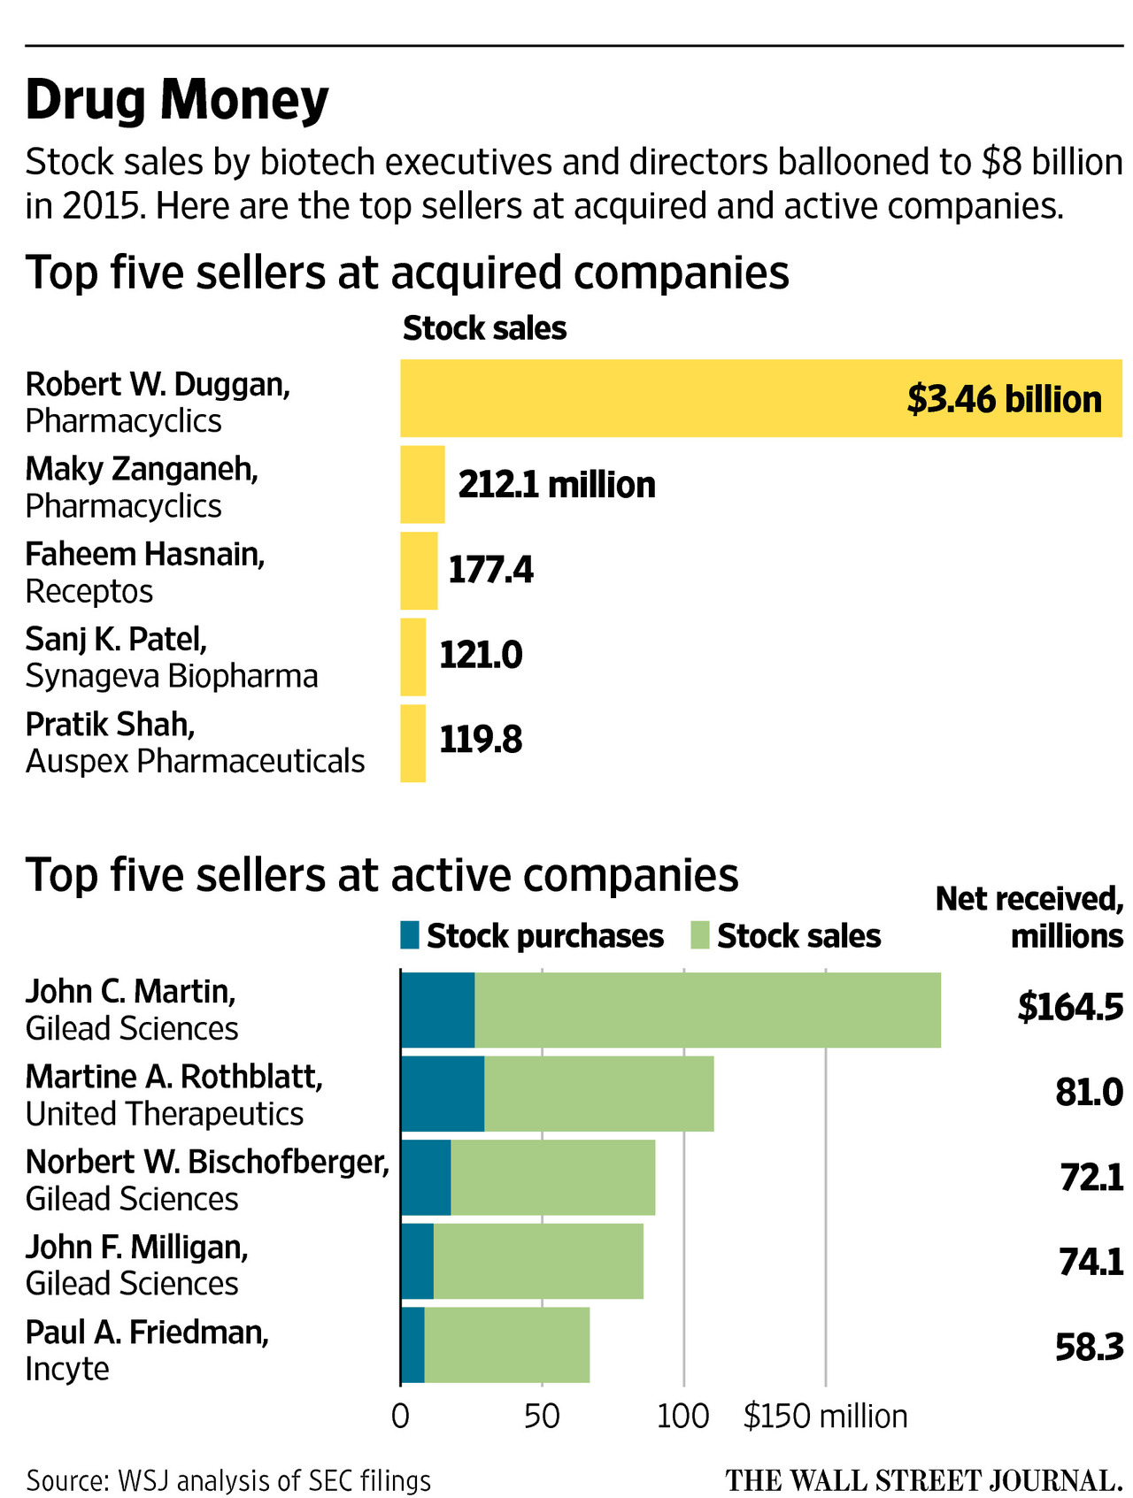

Slide 7
Old News: Pandora
Pandora IPO Prices At $16; Valued At $2.56 Billion
WSJ, 6/15/2011
Pandora Media Inc. continued the trend of hot Internet-related IPOs by pricing its shares at $16 apiece Tuesday night, above expectations.
The company sold 14.7 million initial public offering shares at a level that topped a boosted price range of $10 to $12.
At $16 a share, the offering ended up raising $235 million, almost double the amount originally aimed for earlier this month.
Pandora commands a market capitalization of $2.56 billion for a business that hasn’t made money and has no prospects of earnings at least through January.
Should you invest in P?
  Why?
What are the risks (and expected returns)?
How was the company valued?
      Underwriters: Morgan Stanley, J.P. Morgan, William Blair & Co and Stifel Nicolaus Weisel

Slide 8
Update
Recent Market Valuation=$2B
Chart: Pandora’s Value

Slide 9
A closer look at Pandora
History
    Tim Westergren (founder)
      At IPO, he owned less than 2.3% of the company ($83million)
    Crosslink Capital (more than 20% ownership at IPO)
    Walden Venture Capital (18% ownership at IPO)
    Greylock Partners
    Labrador Ventures
    Hearst Corp (media company)
    GGV Capital (less than 5%)

Slide 10
Finance: Overview and Perspective
  Essential question: How to allocate recourses in order to amass the most wealth while being exposed to the least amount of risk?
      Do I invest in Project A (human capital) or Project B (something else)?
      When do I invest (timing)?
      How do I invest (Ex: Zillow.com)?
  Q: What is an asset?
    A: Anything that has a (positive) value in exchange
      Real Assets--assets used to produce goods and services
      Financial Assets--claims on real assets

Slide 11
  In finance, the general problem is:
    Allocate real assets today to their most productive use
      Allocation across assets at a point in time
    Allocate real assets over time, i.e. allocate between today (for consumption) and tomorrow (investment)
      Allocation across time

Slide 12
  Finance-ology (Finance Axioms):
      Assets tomorrow are worth less than assets today (time value of money)
      Market participants prefer more assets to less
      Market participants don’t like risk (difference between investing and gambling!)
      People are rational; markets are competitive

Slide 13
Classes of Assets
  Equity (Variable Income)
        Common stocks
        Preferred stocks
      Return—unknown ex-ante
  Debt (Fixed Income)
        Fixed Income Instruments: US Treasury Bonds and Notes, Agency Issues (Fed Gov), Municipal Bonds, Corporate Bonds, Mortgage-Backed Securities
        Money Market: Treasury bills, Certificates of deposit, Commercial Paper, Bankers Acceptances, Eurodollars, Repurchase Agreements (RPs), Reverse RPs, Federal Funds
      Interest (coupon) —contractual obligation
      Return—unknown ex-ante
  Derivatives: assets whose value is derived from an underlying asset
      Options
      Futures
      Swaps
      CDS (Credit Default Swaps)

Slide 14
Focus: Financial Sector
Financial Intermediation
    Fed (1914, price stability and long term growth)
    History:
      Security Act (1933) and Security and Exchange Act (1934)
      Glass-Steagall Act (1933)
    Banks (BofA, Chase, Goldman, Morgan)
      Commercial Bank function
      Financial Innovation & Derivatives
      Responding to Regulations & Taxes
    Pension Funds, Insurance Companies, Mutual Funds, Hedge Funds, Private Equity Funds, Venture Capital Funds , Angel Funds …
  Financial markets are built on trust
  Guardians of trust
      FED (Bonds market)
      SEC (Stock market)
      Treasury Department
      FDIC (Commercial Banks)
  Historical perspective
      US has the most successful equity and debt markets, by far, in the last 100 years.
      Looking Forward: New (More) Regulations (2009-2010)--Fed to oversee most financial institutions
        Dodd-Frank Act (2010)

Slide 15
Time Value of Money
    Ex: Suppose you have the following choice:
        Receive $100 now
        Receive $100 in one year for sure (no risk)
      Which one will you choose? Why?
    Suppose you make a $100 deposit into a bank that pays, say, 5% for sure per year.
0yr 1yr
  $100→ 100×(1+0.05)= $105
    $100 today is worth $105 dollars (for sure) one year from now.
      I will be indifferent between receiving $100 today and $105 one year from now for sure. This is the time value of money.
    There is no risk!

Slide 16
    Similarly, in 2 years:
0yr 2yr
  100→ 100×1.05×1.05
  =100×1.05²=110.25
    If you put the $100 for 10 years,
100×1.05¹⁰=162.89
    If you put $PV for n-years, what will the value be?

Slide 17
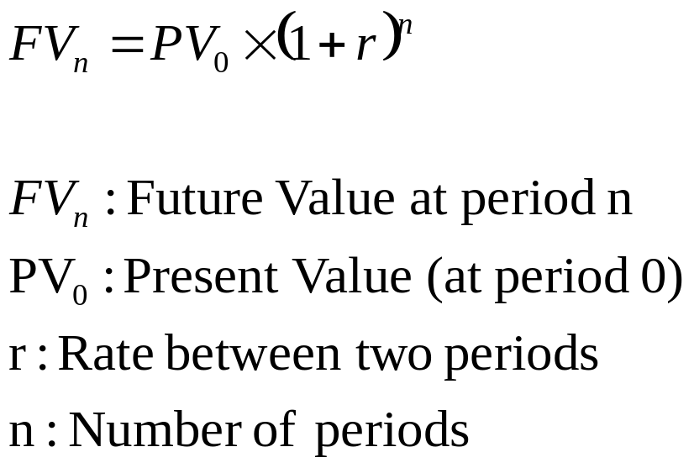
    Future Value
    Plug in:
      Current Amount ($)
      Discount (interest) rate per period (%)
      Number of periods

Slide 18

    Ex: Suppose you set aside a one-time sum of $5,000 for your kid’s future college tuition.
    The amount is invested for 18 years at 8% (compounded annually)?
    In 2035, the account will have $19,980.
      Note: The interest rate is fixed over the period.

Slide 19
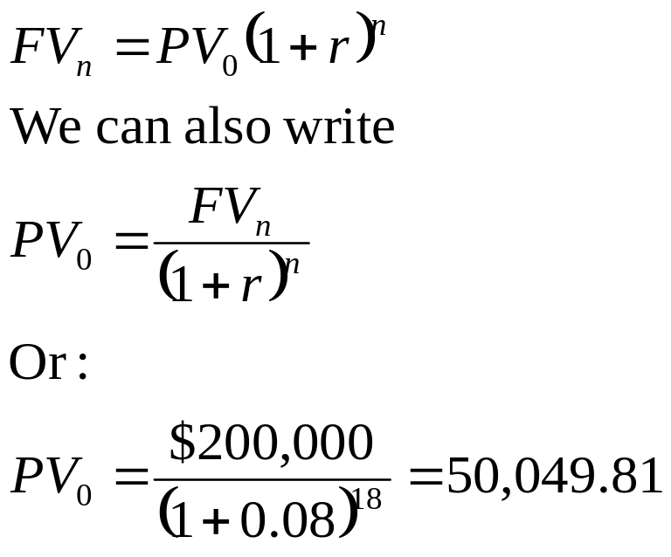
Future Value vs. Present Value
    Q: Suppose you want your kid to have $200,000 for tuition in 18 years. How much money do you have to set aside today?
        You know the future value ($200,000), you want to find the present value.
    Recall

Slide 20
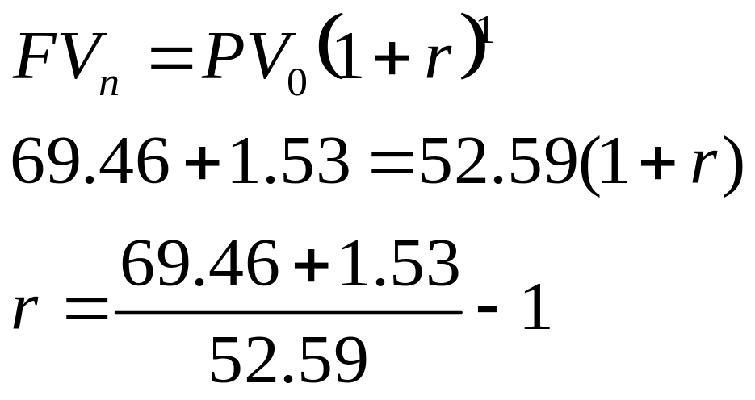
If we have PV and FV, we can compute the return
Suppose we bought MSFT a year ago at $52.59
Currently, MSFT is $69.46
During the year, we received $1.53 in dividends
  Graph
We can use the formula to compute the return

Slide 21
  Example: Financial decision making
      Your company ______ has developed a new product that is attracting a great deal of interest.
        Company A offers you $1,000,000 to buy the product immediately.
        Company B offers you $1,000,000 in 1 year for the product.
        Company C offers you $500,000 now and $550,000 in 1 year for the product.
        You can choose to reject all offers.
      Q: What offer can you eliminate?
      Q: What offer should you take?

Slide 22
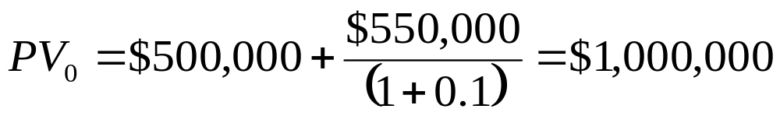
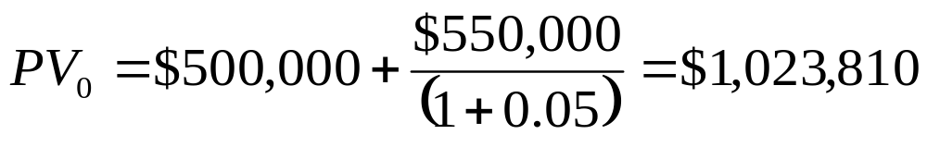
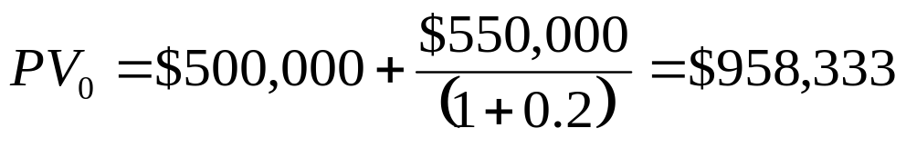
    Offer B is dominated by offer A
        The PV of A is $1,000,000
    The PV of C is (if we assume that r=0.1):
    The PV of C is (if we assume that r=0.05):
    The PV of C is (if we assume that r=0.2):

Slide 23
Old News: Snapchat
Snapchat Spurned $3 Billion Acquisition Offer from Facebook
WSJ, Nov 13, 2013
Snapchat, a rapidly growing messaging service, recently spurned an all-cash acquisition offer from FacebookFB -0.16% for close to $3 billion or more, according to people briefed on the matter.
The offer, and rebuff, came as Snapchat is being wooed by other investors and potential acquirers. Chinese e-commerce giant Tencent HoldingsTCEHY +0.89% had offered to lead an investment that would value two-year-old Snapchat at $4 billion.

Slide 24
More Recent News
Snapchat Parent Snap Valued at $24 Billion After IPO Pricing
WSJ, March 1, 2017
  Snap fetched $17 a share in its offering, the company said, confirming an earlier report by The Wall Street Journal. That gives the parent of popular disappearing-message app Snapchat a market value of nearly $24 billion.
Even more recent news: Recent valuation of Snap

Slide 25
Important:
    The more we discount the future (higher i), the lower the PV of the project (for fixed cash flows)
    Q: How do we determine an appropriate discount rate i?
      Can we assume that i = risk free rate (5%) ?
      Can i be lower than the risk free rate?
      If i is higher than the risk free rate, how much higher? Do we use 7%, 10%, 20%, 50%?
    Q: If ______ rejects all offers, what does it imply about its implicit discount rate?

Slide 26
Perpetuity
  A perpetuity is an investment that makes constant payments forever (CF₁=CF₂=CF₃=…=CF).
      To finance Napoleonic wars, the British government borrowed by issuing British Consol Bonds.
      Instead of repaying their loans, the British government pays (to this day) a fixed annual payment in perpetuity (forever).

Slide 27
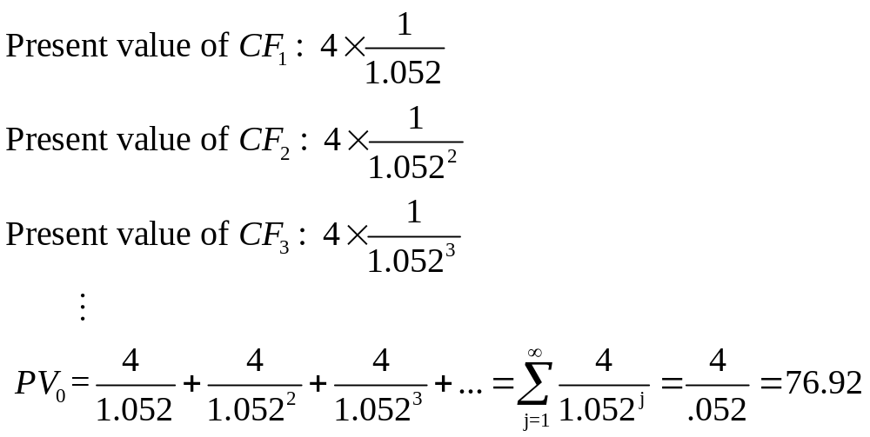
Valuing Perpetuity
    If a British Consol Bond pays £4 a year forever and the interest rate is 5.2% per year?
0 1 2 3… forever...
|--------|-------|-------|--------- (r = 5.2%)
£4 £4 £4 ...forever…

Slide 28
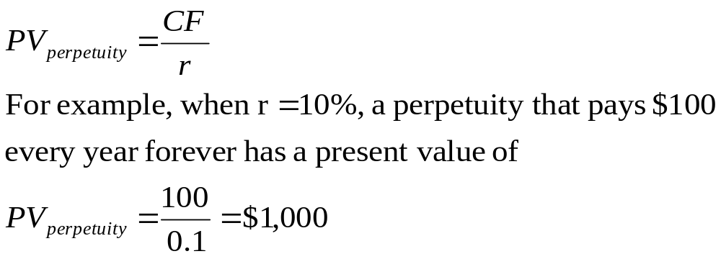
Present Value of a Perpetuity
  In general, the present value of a perpetuity that pays CF forever is

Slide 29
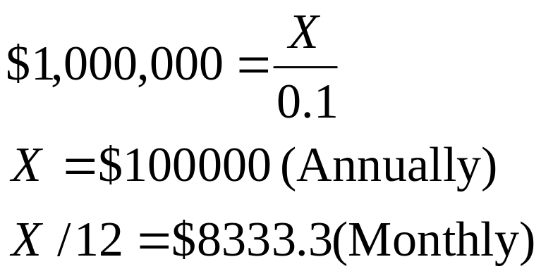
Very useful formula:
  Suppose you borrow $1,000,000 to buy a house around UCSD at 10%.
  What would be the approximate monthly mortgage payment?
  Think of the mortgage as a perpetuity (almost!)
  The true value is a bit higher: $8775.72

Slide 30
Growing Perpetuity
Pays CF in the next period and grows at rate of g (< i) thereafter forever.
0 1 2 3… forever...
|--------|-------|-------|--------- $CF $CF(1+g) $CF(1+g)² ...forever…
Convenient assumption for the valuation of many projects
The growth rate g can be the inflation rate

Slide 31
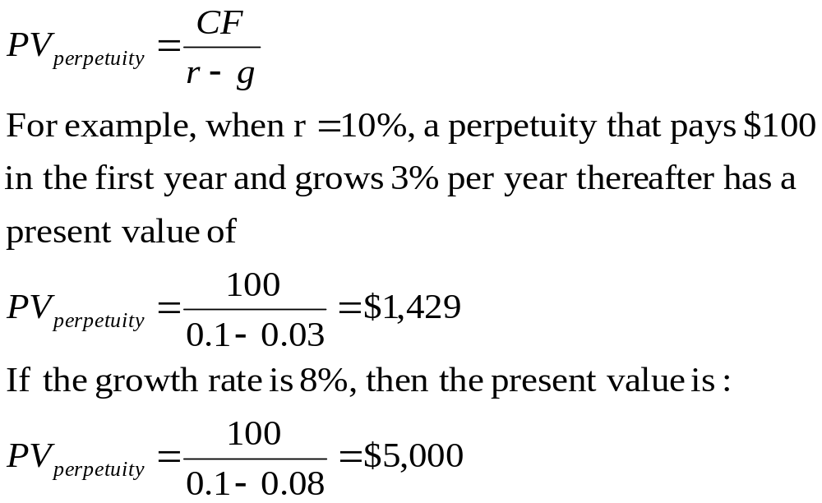
Present Value of a Growing Perpetuity

Slide 32
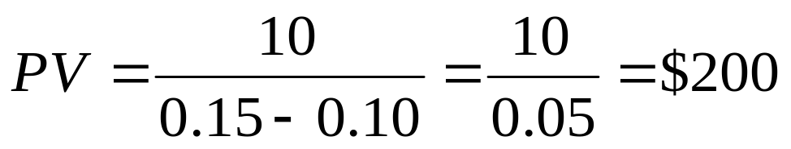
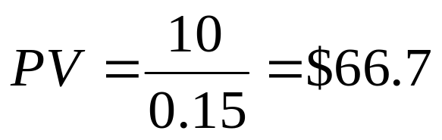
Example: Gordon’s Constant Growth Model
    A common stock is expected to pay a dividend of $10 next year and dividends are expected to grow at a constant rate of g=10% thereafter. If the opportunity cost of investing in this common stock is r=15%, what is the current value of the common stock?
    Without the growth in dividends, the value of the stock is only $66.67.

Slide 33
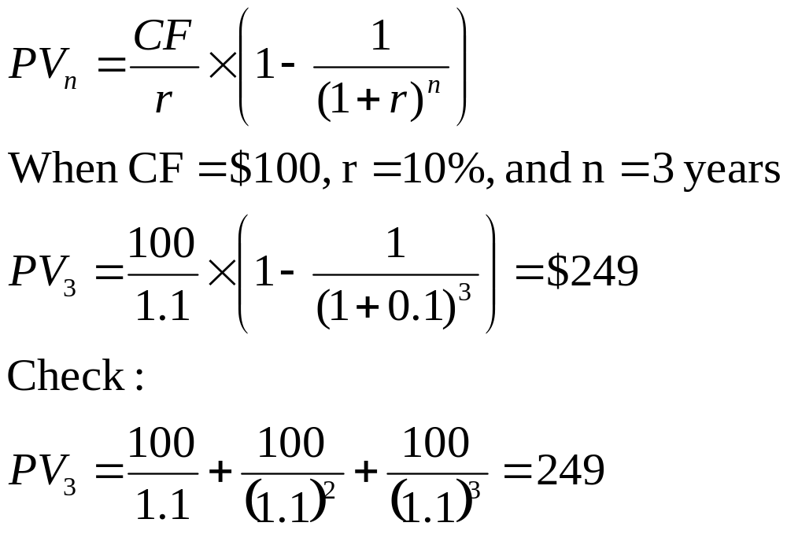
Annuity
  Annuity: A stream of constant cash flows that lasts for a fixed number of periods
0 1 2 3 years
|--------|-------|-------| (r = 10%)
$100 $100 $100

Slide 34
Value of an MBA degree
Suppose you were earning $80,000/year before entering the Rady program and that tuition costs are $35,000/year. Expected salary is $130,000/year after graduation. You can invest money at 6%. Further assume that the first payment of $35,000 has to be made at the start of the program, the second payment one year later.
  PV (Cost of MBA) = $35,000 + $35,000/1.06 = $68,019
Assume that you will work 20 years after graduation, and that the salary differential ($50,000) will continue through this period.
  PV of Benefits Before Taxes = $50,000*(1/.06)*(1-1/1.06²⁰) = $573,496
  This has to be discounted back two years: $ 573,496 /1.06² = $510,409
  NPV of getting an MBA: $510,409 - $68,019 =$442,390
      Fact: NPV of BA: $1,000,000
      Fact: NPV of MBA: $500,000
NPV=Net Present Value

Slide 35
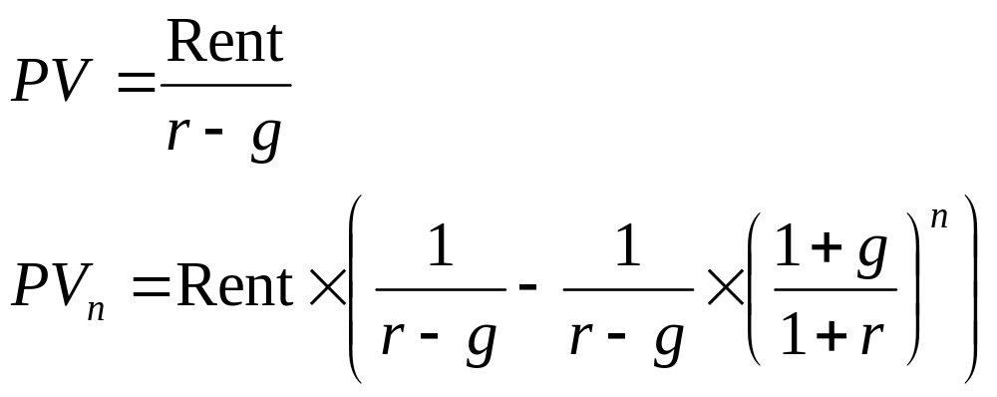
Real Estate: Price=expected future net rents
    Why?
Additional information
    Rent growth—reasonable assumptions
    Discount rate: r
    What formula should we use: perpetuity or annuity?
    Do we need the terminal date (n)?
  Let’s see the calculations!
  Same principles apply to valuing projects, companies, and any other asset

Slide 36
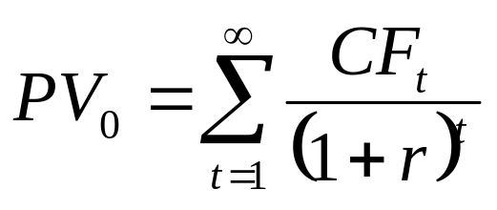
To summarize PV
To compute PV of an asset we need:
  Discount rate
  Future cash flows
Both of those quantities are more or less unknown or uncertain.
Herein lies the valuation problem.

Slide 37
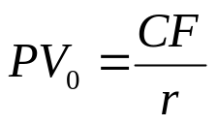
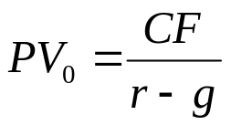
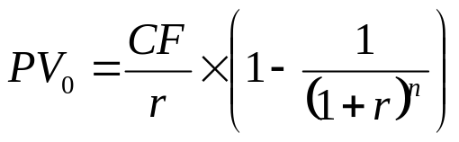
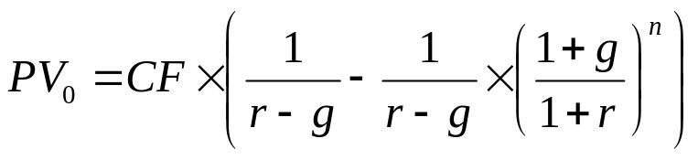
  Summary of Formulas: Special Cases of PV
      Perpetuity: $CF received every year, forever
      Growing Perpetuity: Same as Perpetuity, but $CF grows at rate g forever
      Annuity: $CF grows for T years.
      Growing Annuity: Same as Annuity, but $CF grows at rate g

Slide 38
Q: Where do cash flows and discount rates come from?
    A: In our previous examples, they were given. For some assets, they are more difficult to compute
      Cash flow are different from:
        Net Income
        Earnings
        Other accounting profit measures
      Investors invest cash and demand cash in return!
      They don’t demand “web clicks” or other promises.

Slide 39
Cash Flow Forecasts
Current cash flows are easy to compute, but:
  How to compute an appropriate growth rate of CFs in order to generate forecasts of future cash flows?
    This implies making forecasts of CFs
    What growth rate is reasonable (economically speaking)?
    Boundaries?

Slide 40
Future Cash Flows:
  The growth of the US economy is about 3% per annum
    Large companies grow at about that rate
    Small companies might grow at a faster rate, but only in the short term
    At perpetuity, their growth rate cannot exceed 3-4%.
      Temporarily, it might be quite high (20% to 30%)
    Example: QCOM
      The growth rate of QCOM cannot be 25% at perpetuity, because if it were, the company will be larger than the US economy in about 15 years
      Competition will bring the growth rate down over the long run

Slide 41
Discount Rate
Discount Rate: Tougher question
  Suppose you are given the cash flows of two companies
    CFs of company A are guaranteed to be $2.143B and to grow at 5% forever.
    CFs of company B are not. Next year, me might have $2.143B or $0.5B or $3.6B. How do we discount cash flows (and compare PVs) in this case.
    Company B is riskier than company A?
    Investors don’t like risk. In other words, to bear risk, they have to be compensated.

Slide 42
Risk=Variance
  Risky CFs means that the CFs vary a lot, or that their variance is large
    The higher the risk, the higher the variance.
  An asset that has no risk is called riskless or risk-free.
    Treasury bills, CD accounts, etc. are riskless.
    We know exactly what we are going to get at maturity. The return of such riskless securities is 0.5% today
        Historically: riskless rate=5%
  An asset that has some risk (variance), is risky.
    Examples of risky assets (increasing risk):
      Corporate Debt (Corporate Bonds)
      Real Estate
      Stocks
      Human Capital
      Private Equity
      VC

Slide 43
In general, the higher is the risk of an investment, the higher will be the return
    Otherwise, people will not invest
  Rough categorization
    Risk-free asset: historic average return: 5%/annum
    Corporate Debt (AA): historic average return: 9%
    Real Estate: 10%
    Stocks: 12%
    Human Capital: ?
    Private Equity: 20%
    VC: 30-40%.

Slide 44
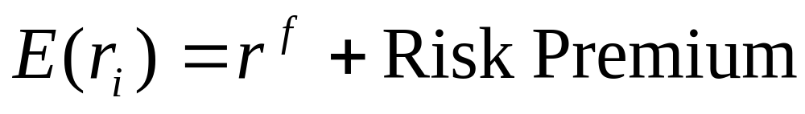
  Intuitively, we have
  The question is, how do we determine the premium for the different assets in a more rigorous way
      Aside: How is the risk-free rate determined?

Slide 45
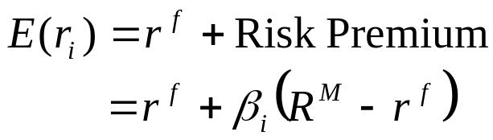
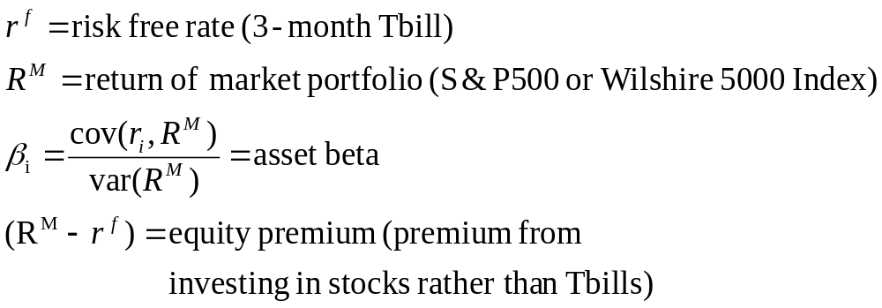
How Much to Risk-Adjust?: The CAPM
    A: Since investors don’t like risk (axioms), they have to be compensated for bearing risk.
      The higher the risk, the higher the compensation.
      where
    Where does this formula come from?
      Sharpe (Nobel Prize Winner)

Slide 46
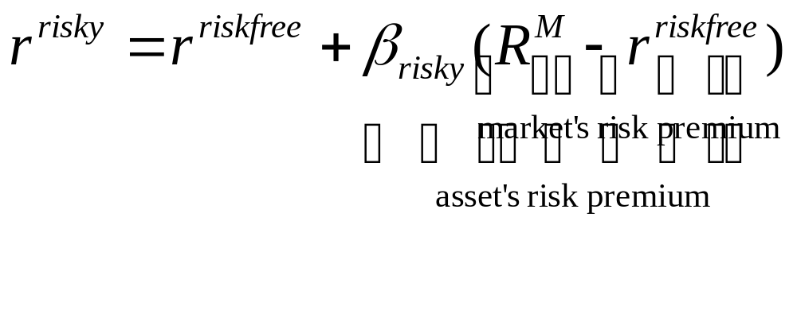
Comments on the CAPM
  Beta=0, no market risk
  Beta=1, same risk as the market portfolio
  High beta = high asset return
  High beta = high asset risk
  No “corporate” beta
    Each project has its own risk-return and beta
  Criticism: The only source of risk is market fluctuations

Slide 47
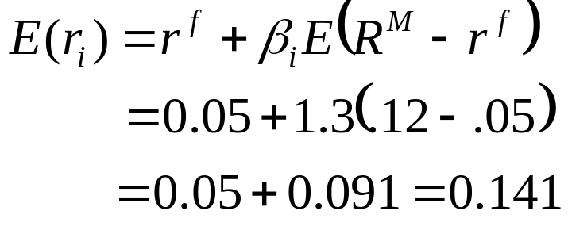
Example: QCOM
Let’s check!
Premium for investing in a risky stock

Slide 48
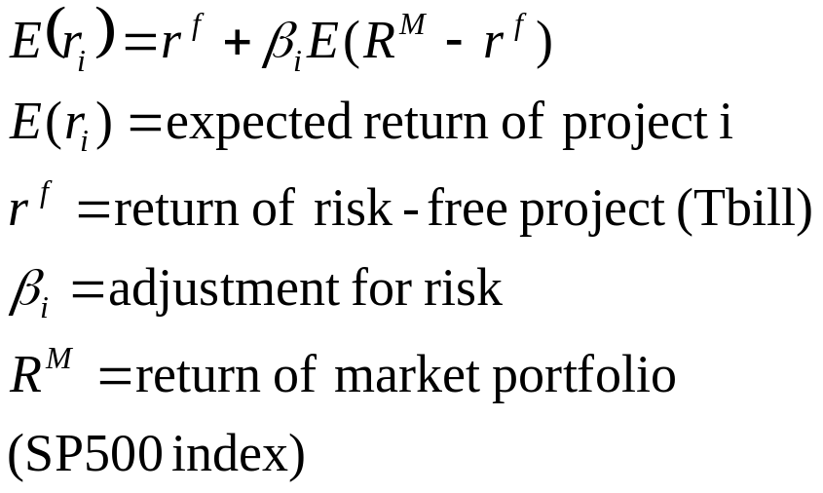
Visualizing Risk Adjustment
Slope=β_{i}
Expected
Return (r_{i})
Risk-free
(r^{f})
Risk

Slide 49
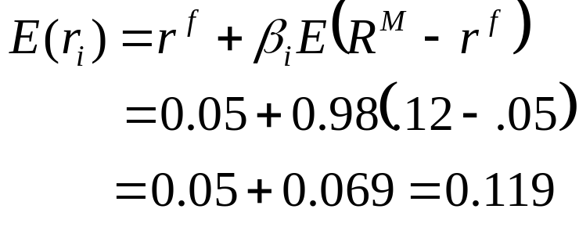
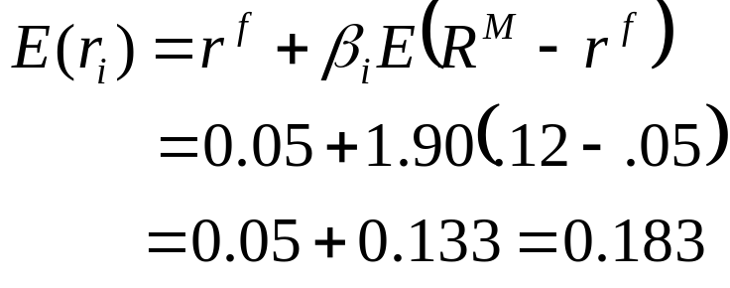
Example: Cubic
  Let’s check!
Example: FSLF (First Solar)
  Let’s check!
Premium for investing in a risky stock

Slide 50
Capital Budgeting, NPV, and Alternative Investment Rules
To decide amongst projects, managers need to have a clearly defined objective function.
Popular objective functions
    Payback period
    Net present value (NPV)
    Profitability index (PI)
    Internal rate of return (IRR)

Slide 51
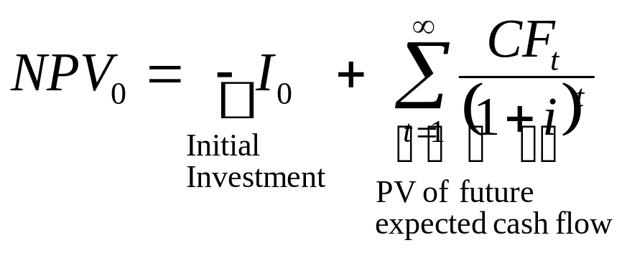
Net Present Value (NPV) Criterion
Net Present Value (NPV) is the present value of expected future cash flows minus the initial investment.
Rule: Undertake positive NPV projects!

Slide 52
Example: NPV
Assume a discount rate of 10% per year. Will you accept the following projects?
Project A
  Initial investment: $10,000
  Year 1 Cash flow: $11,000
  Year 2 Cash flow: $12,100
Project B
  Initial investment: $4,000
  Year 1 Cash flow: $22,000
  Year 2 Cash flow: $-12,100

Slide 53
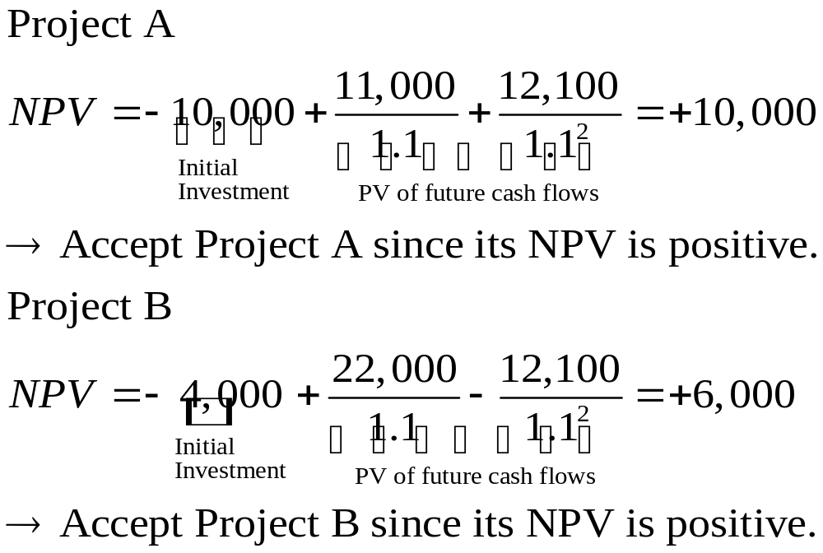

Slide 54
Conclusions
  Both projects increase the value of the company. If possible, invest in both.
    Rule 1: Invest in positive NPV projects.
  If we have to make a choice (we don’t have $14,000 to invest), choose project A.
    Rule 2: Choose the highest NPV projects first.

Slide 55
NPV rule: Pros and Cons
Pros
  Time Value of Money is taken into account.
  Can adjust for risk (through discount rate)
  Clear decision criterion (undertake project if positive NPV)
  Consistent with maximizing shareholder wealth
    Increases company value
Cons
  Difficult to rank projects when funds for initial investment are limited.
    Q: In the previous example, do we prefer project A or B?

Slide 56
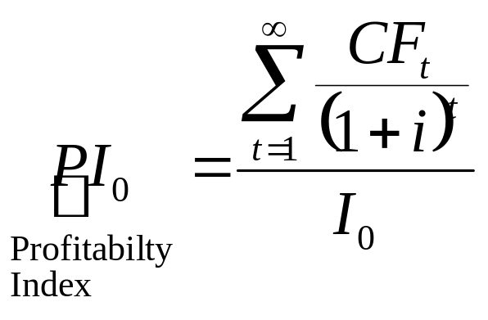
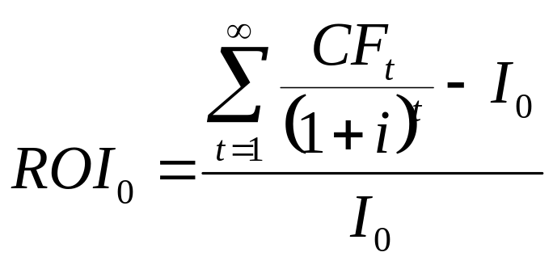
Profitability Index (PI) and Return on Investment (ROI)
The ratio of PV of expected future cash flows divided by initial investment. Also called the Benefit/Cost ratio.
  Accept projects where PI > 1.
  Projects with higher PI is preferred when limited funds are available.
ROI:

Slide 57
Example: PI
Assume a discount rate of 10% per year. If you can take only one project, which one will you choose?
Project A
  Initial investment: $10,000
  Year 1 Cash flow: $11,000
  Year 2 Cash flow: $12,100
Project B
  Initial investment: $4,000
  Year 1 Cash flow: $22,000
  Year 2 Cash flow: $-12,100

Slide 58
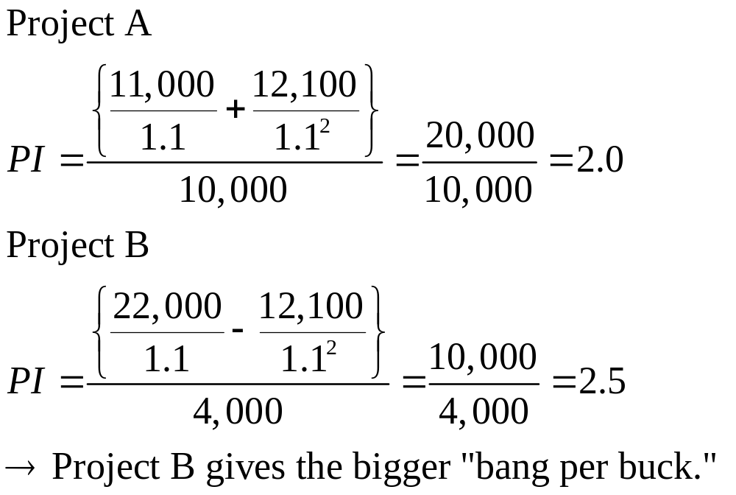

Slide 59
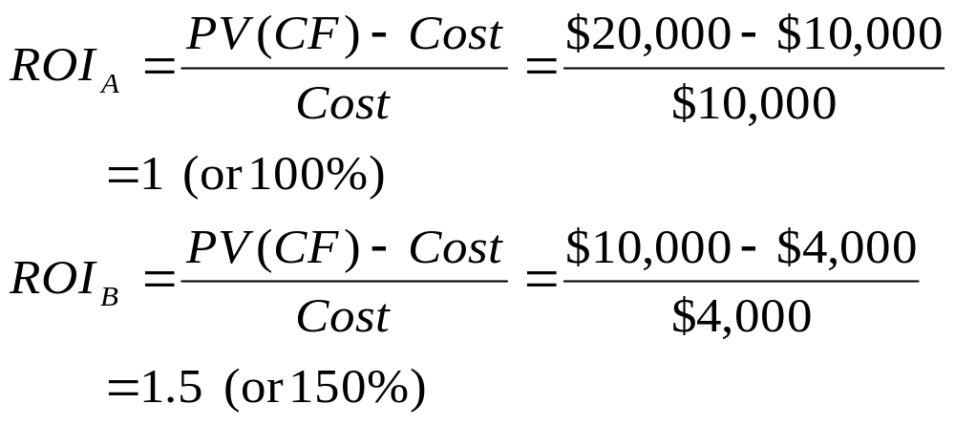
Let’s compute the ROI of both projects:

Slide 60
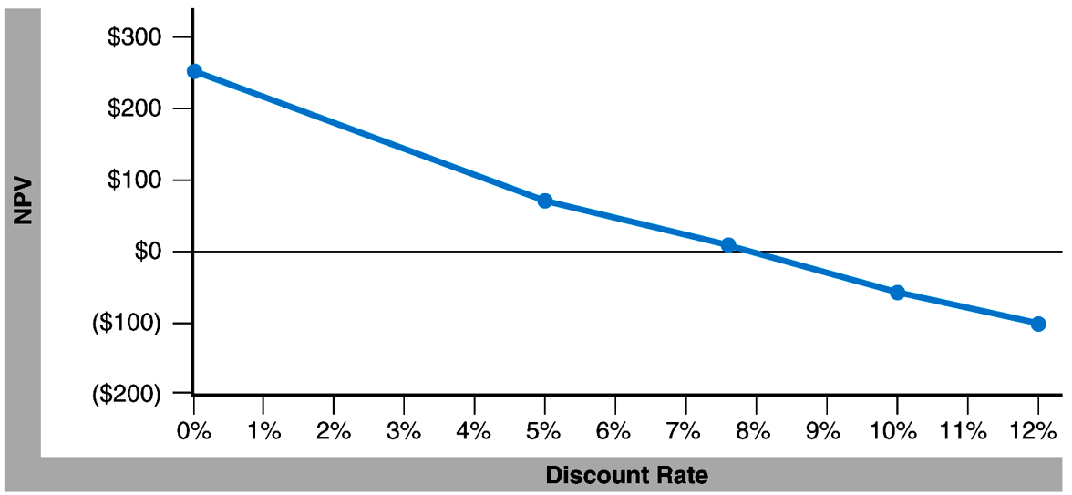
NPV and Discount Rate
NPV decreases as the required discount rate increases.
What is the cut-off discount rate for a project to be accepted (i.e., positive NPV)?

Slide 61
Internal Rate of Return (IRR)
Look at the discount rate of a project that makes the project’s NPV=0.
  IRR is the discount rate that equates the present value of future cash flows to initial investment.
  We accept a project if IRR > required discount rate (“hurdle rate”).

Slide 62
Example: NPV and IRR
Assume a discount rate of 10% per year. Let us compute the NPV and the IRR for each project.
Project A
  Initial investment: $20,000
  Year 1 Cash flow: $11,000
  Year 2 Cash flow: $12,000
Project B
  Initial investment: $20,000
  Year 1 Cash flow: $32,000
  Year 2 Cash flow: $-10,000

Slide 63
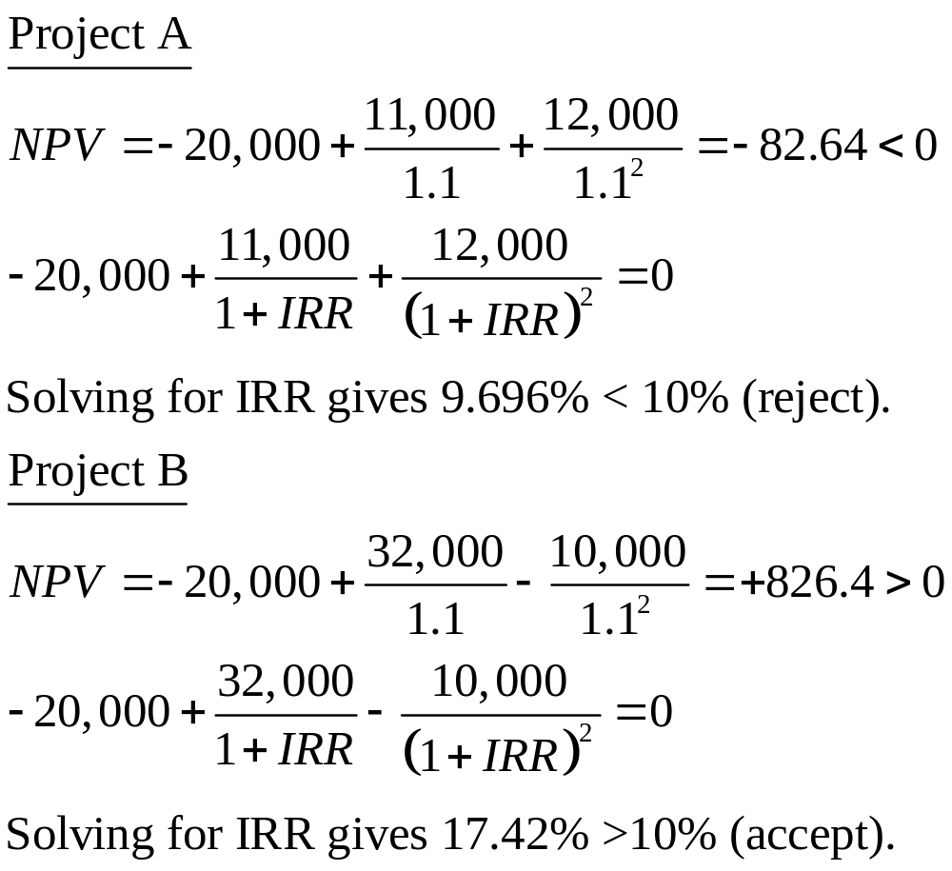

Slide 64
NPV and IRR do not always provide the same answer. Suppose you have the following investments (i=10%).
    Project A: Invest $10 now and get $12 in 1 year
    Project B: Invest $100 now and get $112 in 1 year
    NPV_{A}=0.91; NPV_{B}=1.81. Choose Project B!
    IRR_{A}=0.2; IRR_{B}=0.12. Choose Project A!

Slide 65
About the IRR
  Good: Sometimes it is easier to interpret and communicate the IRR than the NPV
  Problem: Serious computational issues. Because IRR is a solution to a polynomial equation:
    There may be no solutions. There may exist multiple solutions IRR is usually found by trial and error
    Tip: Graph NPV as a function of the discount rate (see above).
  IRR and NPV do not always provide the same answer.
    IRR should be used to rank projects only if cash constrained. Do not select the project with the largest IRR.

Slide 66
To Summarize Optimal Capital Budgeting Decisions
  Companies should use NPV.
  IRR and ROI should be used with caution (when constrained)
  Other methods, such as payback are clearly not adequate.
  Only deficiency of NPV decision making is that it is a static setting– does not realize certain options.

Slide 67
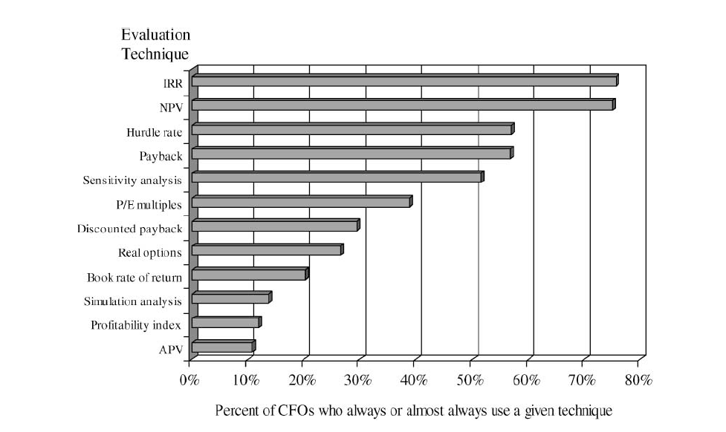
Evidence from the field (Graham and Harvey, 2001)

Slide 68
Other stylized facts on Capital Budgeting
  Large firms are significantly more likely to use NPV than small firms
  Small firms use payback criterion almost as often as they use NPV or IRR
  Highly levered firms are significantly more likely to use
    NPV and IRR than firms with small debt ratios
    sensitivity and simulation analysis
  CEOs with MBAs are more likely than non-MBA CEOs to use NPV
  CEOs w/o MBAs are more likely to use payback
  Payback is most popular among seasoned CEOs

Slide 69
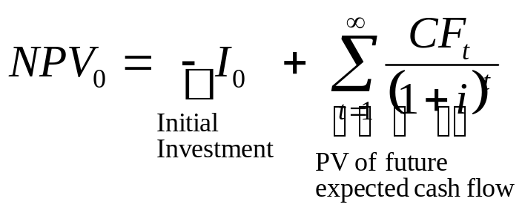
  From the previous discussion, we will use NPV!
  The formula is
      If NPV>0, invest!
      If NPV<0, do not invest!
  To compute NPV, we need:
      Future cash flows
      Discount rates
  We can look at the problem slightly differently:
      What is the value of a project, company, etc?
      What is the fundamental price of an asset?
      If I want to sell a project, what should be the asking price?
      If I want to take my company public/ask for VC money, how much should I ask for it?

